Slide 1
Analyzing Amazon Sales Data Done by : Kalluri Gopi Kiran UNID:UMIP6266

Slide 2
agenda
Introduction 3
Goal of Project 4
Proposed work 5
Visualizing the Data 6-9
Insights and conclusion 10-12

Slide 3
Introduction The Amazon Sales Power BI dashboard offers a comprehensive and real-time overview of sales performance on the Amazon platform. It integrates and visualizes critical sales data, enabling sellers and business stakeholders to gain valuable insights and make data-driven decisions. The dashboard provides a user-friendly interface with interactive charts, graphs, and filters, allowing users to analyze sales trends, monitor product performance, and identify growth opportunities. Key metrics such as revenue, units sold, average order value are presented, empowering users to track performance across different time frames, product categories, and geographical regions. With this powerful tool, sellers can optimize their strategies, understand customer behavior, and drive business growth on the Amazon marketplace

Slide 4
Goal of Project
As the creator of the Amazon sales analysis dashboard using Power BI, goal was to gain a better understanding of sales performance on Amazon.
By visualizing and analyzing sales data, wanted to identify patterns, trends, and insights to optimize sales strategy, improve profitability, and make data-driven decisions. Including this dashboard in my portfolio demonstrates proficiency in data analysis and visualization tools, and ability to use data to drive business outcomes.

Slide 5
Proposed Work
Data collection: Collected sales data .
Data cleaning and preparation: Cleaned and transformed the data to ensure it was accurate, complete, and consistent.
Data modeling: Designed a data model that organized the data in a way that made it easy to analyze and visualize.
Data visualization: Used Power BI to create charts, tables, and other visualizations that presented the data in a way that was easy to understand.
Analysis and insights: Analyzed the visualizations to identify trends and insights that informed business decisions.

Slide 6
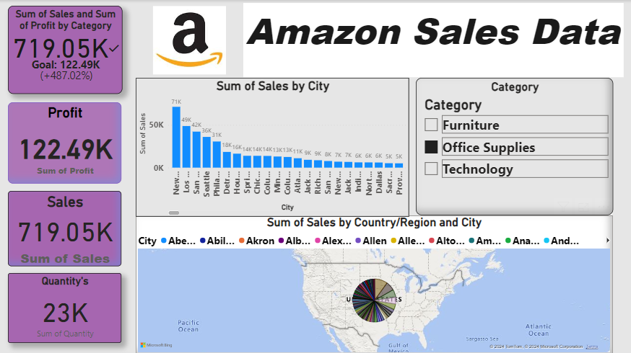
Visualizing the Data

Slide 7

Visualizing the Data

Slide 8
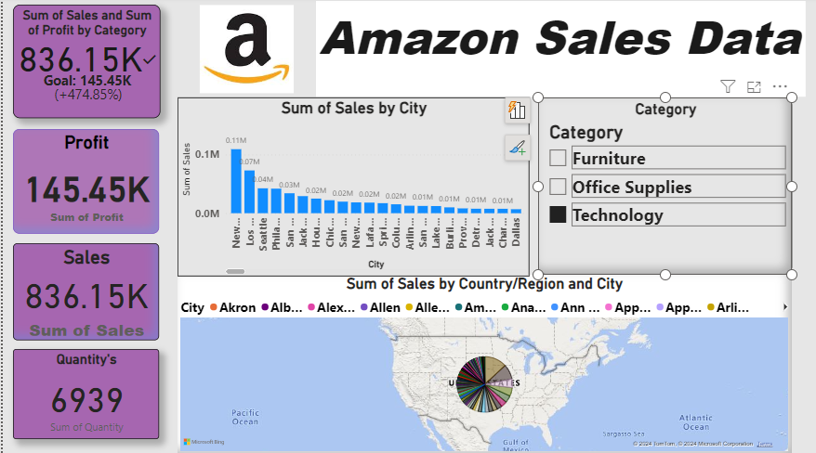
Visualizing the Data

Slide 9
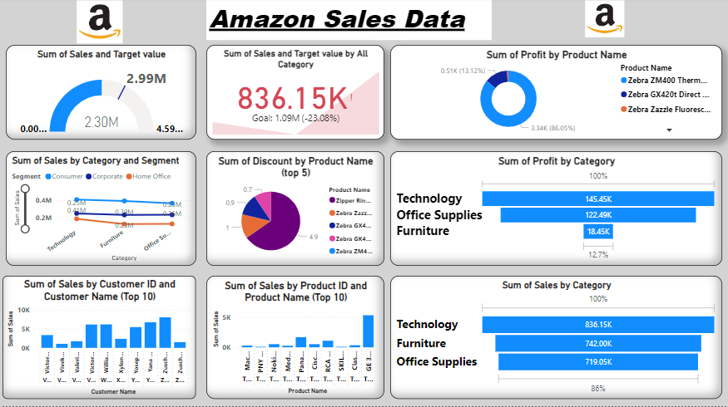
Visualizing the Data

Slide 10
Insights and Data Analysis
Sales are not exceeding targets: The total sales figure of $2.30M is significantly Lower than the goal of $2.99M. This indicates that the company is not performing up to the mark set by the company.
Technology is the most profitable category: The Technology category has the highest profit of $1,45,000. This suggests that the company is making a significant amount of money from selling Technology Sector items.
Furniture is the lowest profitable category: The furniture category has the lowest profit of $18,000. This suggests that the company is making a less amount of money from selling furniture.
Technology have the highest sales: Technology have the highest total sales of $8,36,750.
Office supplies have the lowest sales: Office supplies have the lowest total sales of $7,19,490.
Office supplies have the highest No of Quantity’s Sales : Office supplies have the highest No of Quantity’s total sales of $23,000.
. Technology category have the lowest No of Quantity’s sales: Technology have the Lowest No of Quantity’s total sales of $6,939.

Slide 11
Insights and Data Analysis
Sales are exceeding targets in the category of Furniture: The total sales figure of $18,000 is significantly higher than the goal of $7,42,490. This indicates that the company is performing well above expectations in the sector of Furniture.
Sales are exceeding targets in the category of office supplies: The total sales figure of $7,19,050 is significantly higher than the goal of $1,22,490. This indicates that the company is performing well above expectations in the sector of office supplies.
Sales are exceeding targets in the category of Technology: The total sales figure of $8,31,150 is significantly higher than the goal of $1,45,450. This indicates that the company is performing well above expectations in the sector of Technology.
Zebra brand printers are popular: Two of the top five products by sales are Zebra brand printers (Zebra ZM400 and Zebra GX420t). This suggests that Zebra printers are a popular product among the company's customers.
Product name and product ID which secured highest sum of sales $5,291 is TEC-PH-10004977 GE 30524EE4.
Customer ID Customer Name which secured highest sum of sales $8,025 is ZC-21910 , Zuschuss Carroll.

Slide 12
Conclusion
Finally, our journey through the realm of Amazon sales data, powered by the analytical prowess of Power BI, has illuminated invaluable insights and opportunities for strategic growth. By dissecting vast streams of data, we've unearthed trends, patterns, and correlations that not only shed light on past performance but also pave the way for future success.
Through meticulous analysis, we've identified key drivers of revenue, optimized marketing strategies, and honed in on customer behaviors that can be leveraged to enhance the overall shopping experience. Armed with this knowledge, we stand poised to make informed decisions that will propel our business to new heights.

Slide 13
thank you

